Slide 1
GestureTalk Real-Time Sign Language Recognition and Animation System Using AI
Roll No | Name of the Student
21AG1A6708 | B Srikanth
21AG1A6743 | MD Shafee
21AG1A6748 | M Vijaya Lakshmi
21AG1A6701 | A Shravan Kumar
Under the supervision of Mr. K Kiran Babu
CSE(Data Science)
ACE ENGINEERING COLLEGE

Slide 2

Introduction
Communication between deaf and hearing individuals often presents challenges due to differences in language modalities. This project aims to bridge that gap by developing a real-time interface that enables seamless, bidirectional communication. By integrating advanced technologies such as speech recognition, natural language processing, gesture detection, and 3D avatar animation, the system converts spoken language into sign language and vice versa. Real-time sign recognition using YOLO and DWpose ensures accurate gesture detection and realistic sign representation. This innovative solution promotes inclusivity and accessibility, especially in digital interactions like video calls, empowering the deaf community to engage more effectively with the hearing world.

Slide 3
Existing System
Human Interpreters – Accurate but not always available.
Text-Based Tools – No support for sign language.
Avatar Apps – Basic signs, lack realism.
Gesture Recognition – Limited accuracy and vocabulary.
One-Way Systems – Only speech-to-sign or sign-to-text.

Slide 4
Proposed System
The proposed system enables real-time, bidirectional communication between deaf and hearing individuals by combining AI technologies. It has two main modules:
Speech/Audio to Sign Language Video
Speech Recognition converts spoken input to text using ASR (Automatic Speech Recognition).
NLP Processing translates English text into ASL gloss.
Sign Video Generation uses a 3D avatar animated via DWpose for realistic sign representation.
Sign Language Video to Text
Gesture Detection uses a YOLO-based model trained on WLASL/MS-ASL datasets to recognize hand gestures in real time.
Pose Estimation (DWpose, MediaPipe) improves accuracy and tracks hand/body movements.
Recognized signs are converted to text, enabling hearing users to understand.

Slide 5
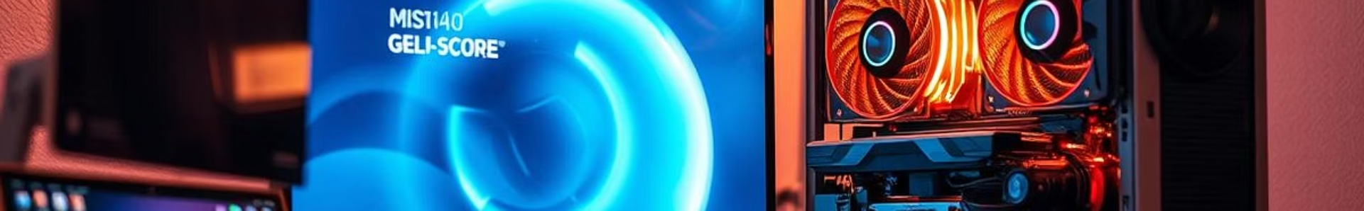

Software Requirements
Operating System: Windows 10 / 11 or Ubuntu (Linux)
Programming Language: Python 3.7 or above
Libraries & Frameworks:
OpenCV – Video processing
MediaPipe / DWpose – Pose estimation
YOLO – Gesture detection
TensorFlow or PyTorch – Deep learning models
SpeechRecognition or Whisper – Speech-to-text
NLTK / SpaCy – NLP for ASL gloss
Flask / FastAPI – Backend APIs
Tools:
LabelImg – Dataset annotation
VS Code / Jupyter Notebook – Code development

Slide 6
Hardware Requirements
Webcam – For capturing sign gestures.
Microphone – To input spoken language.
GPU-enabled PC/Laptop – To run AI models smoothly (e.g., NVIDIA GPU).
8 GB RAM (minimum) – For handling real-time processing.
i5 Processor or higher – For efficient computation.

Slide 7
Functional Requirements
Speech-to-Text Conversion
System should convert spoken input into text using ASR.
Sign Gesture Detection
System should detect and recognize sign gestures from live webcam input.
Sign-to-Text Translation
Detected gestures should be translated into readable English text.
Real-Time Processing
All translations and detections should occur in real time with minimal latency.
User Interface
System should provide a simple interface for users to input speech or view sign animations.

Slide 8
Non-Functional Requirements
Real-Time Performance – Fast response with minimal delay.
High Accuracy – Reliable speech and sign recognition.
User-Friendly – Simple and intuitive interface.
Scalable – Easy to expand with more features or languages.
Reliable – Stable performance without frequent errors.
Portable – Runs on standard PC/laptop setups.
Maintainable – Easy to update and improve.

Slide 9
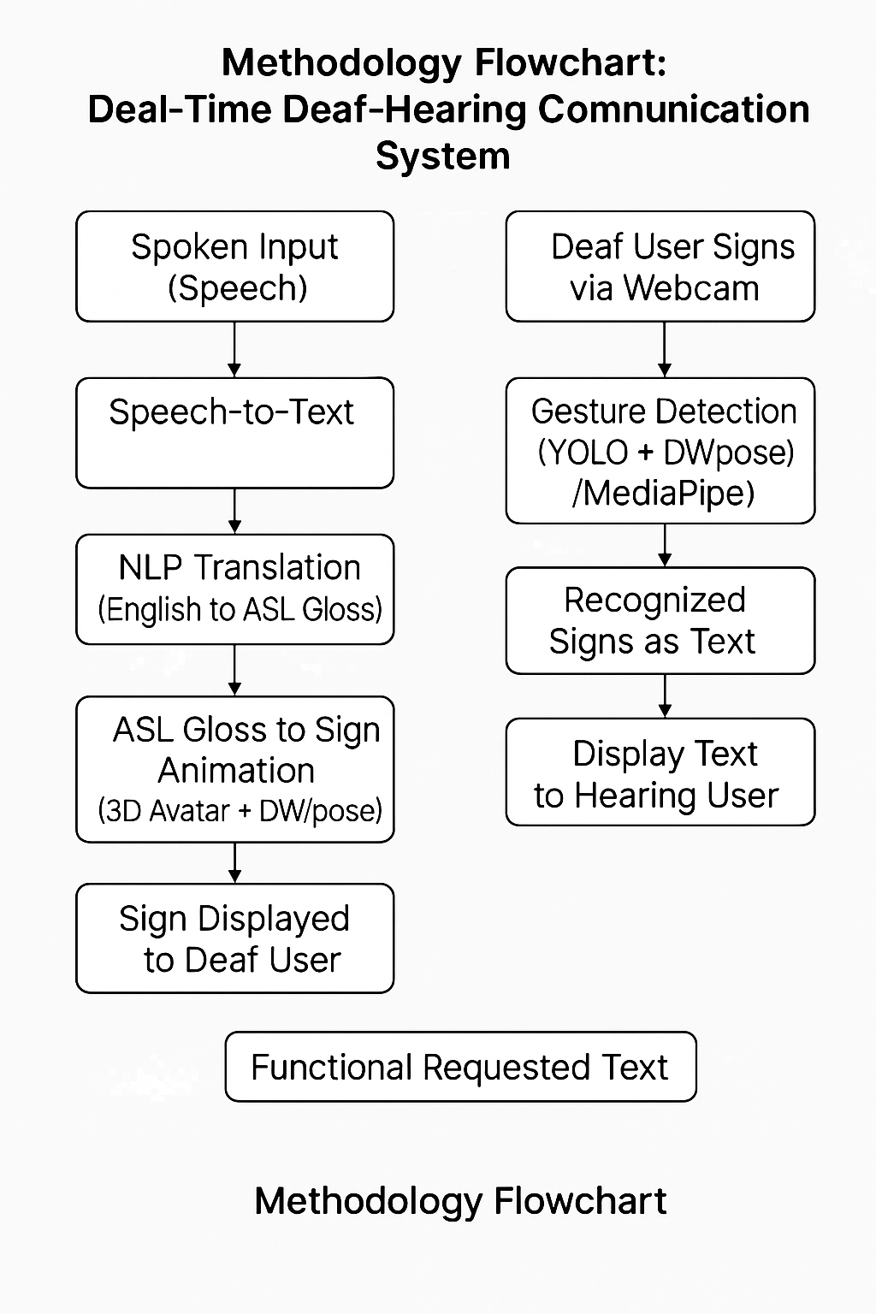
Methodology :

Slide 10
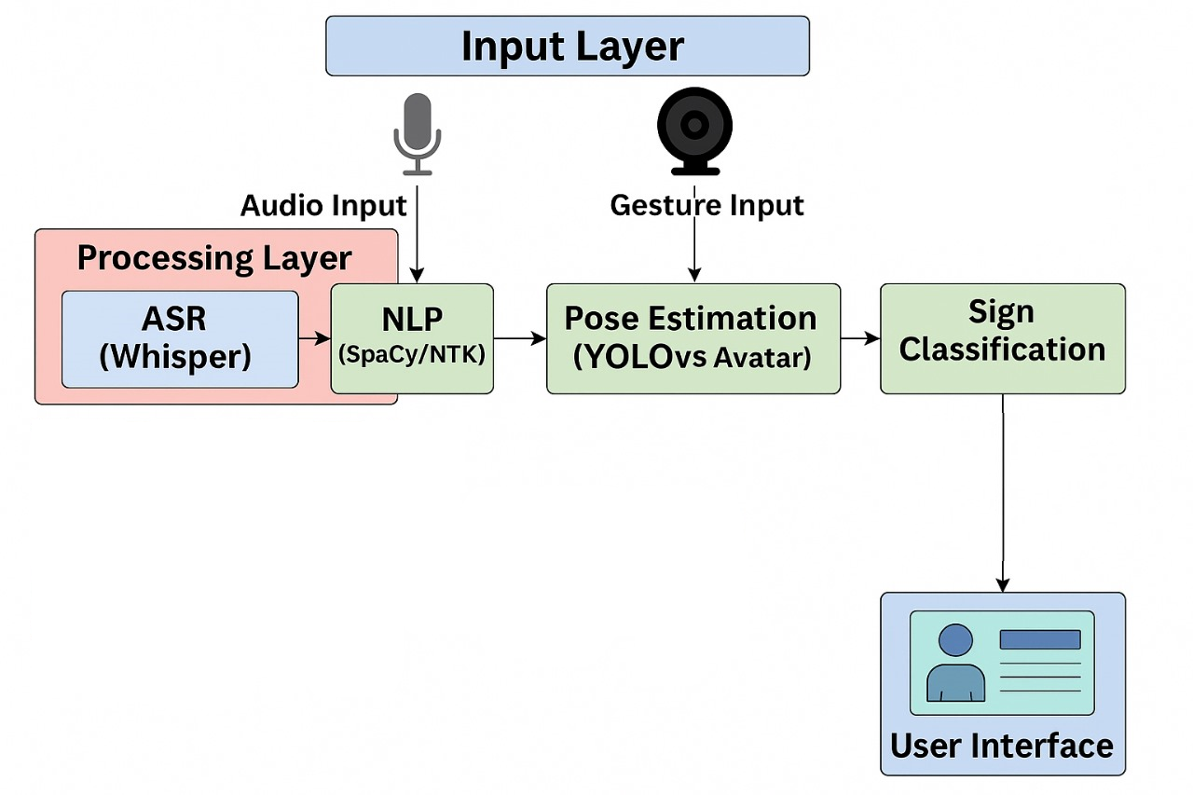
System architecture

Slide 11
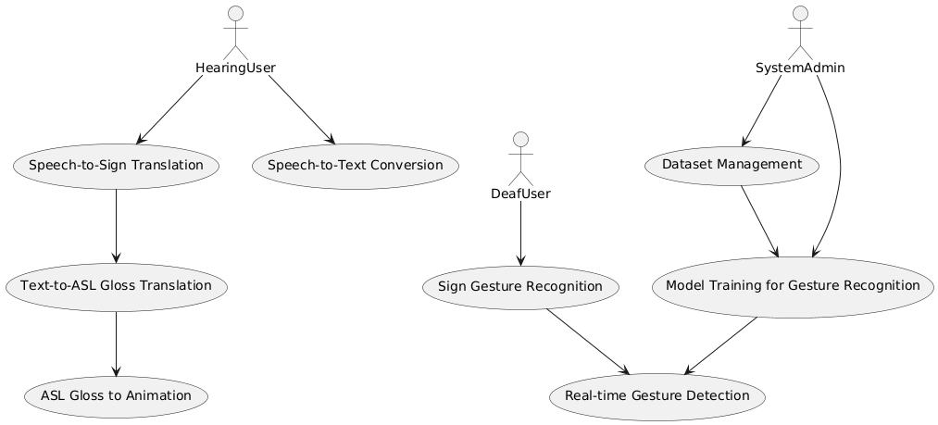

Use Case Diagram

Slide 12
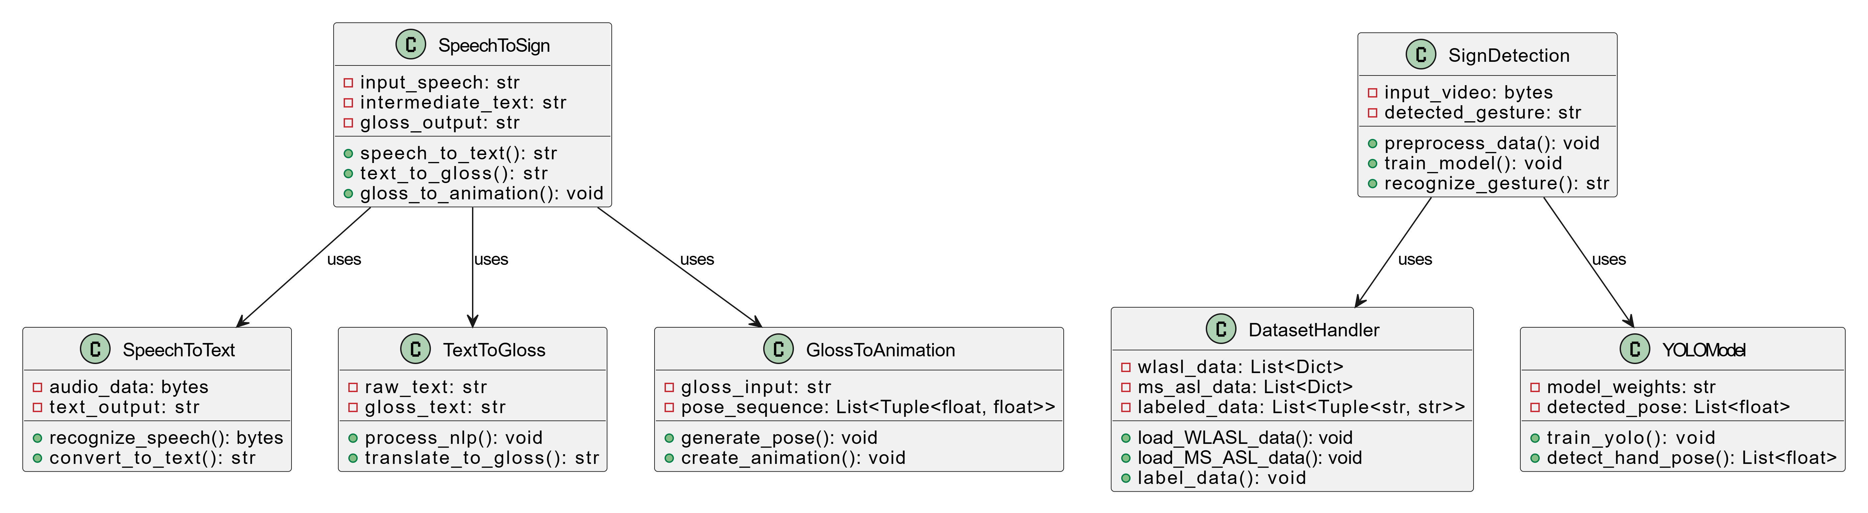
Class Diagram

Slide 13
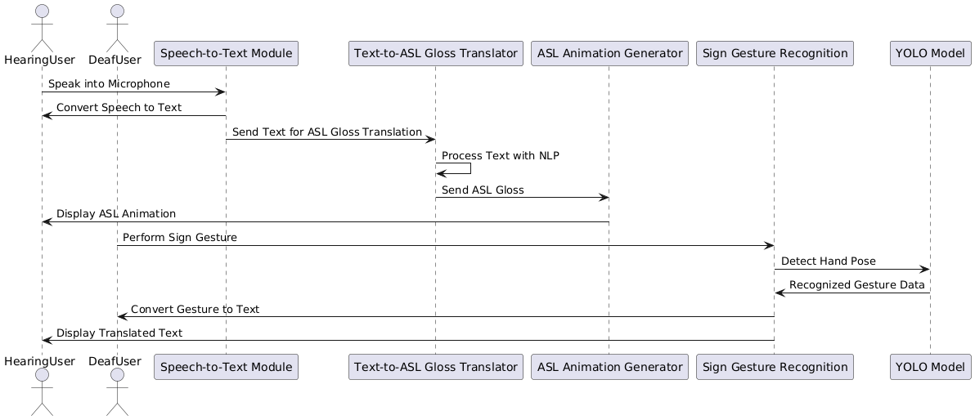

Sequence Diagram

Slide 14
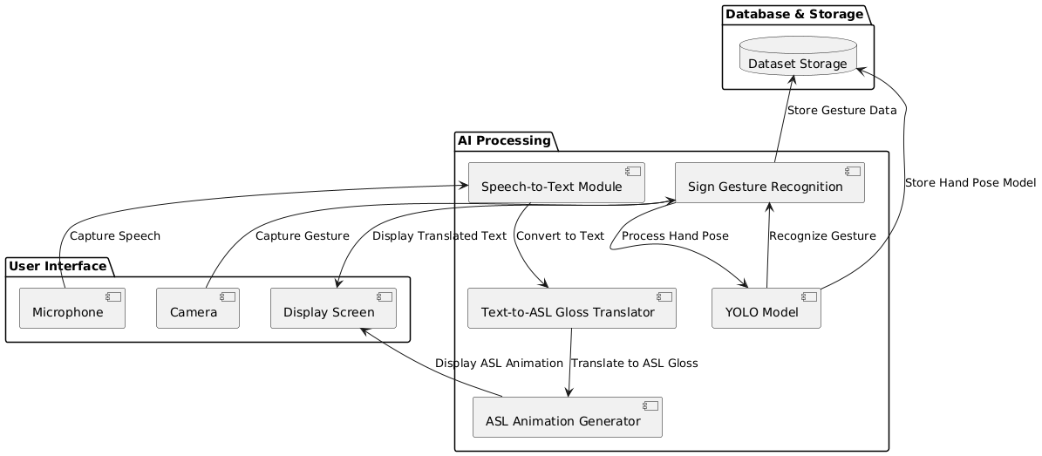
Component Diagram

Slide 15
References
WLASL: A Large-Scale Dataset for Word-Level American Sign Language Recognition
Li, Dongxu, et al.
Proceedings of the IEEE Conference on Computer Vision and Pattern Recognition (CVPR), 2020.
YOLOv5: Real-Time Object Detection
Jocher, Glenn et al.
Available on GitHub: https://github.com/ultralytics/yolov5
Whisper: OpenAI’s Automatic Speech Recognition Model
OpenAI, 2022
GitHub: https://github.com/openai/whisper
MediaPipe: Cross-platform framework for building multimodal applied ML pipelines
Google Research
https://mediapipe.dev
Sign Language Recognition Using CNN-RNN Architecture
Pigou, Lionel, et al.
Journal of Machine Learning Research, 2018.

Slide 16
Conclusion
This project presents an AI-based real-time communication system that bridges the gap between deaf and hearing individuals. By integrating speech-to-text conversion, ASL gloss translation, and animated sign generation, the system effectively translates spoken language into sign language. Conversely, it uses gesture detection and pose estimation to convert sign language back into text, enabling bidirectional communication. The use of advanced technologies like YOLO, DWpose, and NLP ensures high accuracy and real-time performance. This system enhances accessibility and inclusivity, especially in virtual communication scenarios such as video calls. It provides a scalable solution for empowering the deaf community in digital interactions.

Slide 17
Thank You

